Slide 1
Encouraging Behavior Change
Through Education and Marketing

Slide 2
Why Public Education & Outreach?
Education and outreach may not be the major goal of your project, but they benefit our stakeholders in ways that may not be apparent at first glance.
The most obvious benefit of outreach programs is also one of the most discounted: community engagement and town-grown relations.
Too often, locals come to think of government entities and programs as money-wasting institutions that are gobbling up tax-payer dollars with little return on the investment.
Notes:
They may not be major contributors to the standard university and faculty goals of academic research or scholarly publications, but they benefit our stakeholders nonetheless and in ways that may not be apparent at first glance.

Slide 3
Why Public Education & Outreach?
Effective public education and outreach is a part of our responsibility to:
  Increase knowledge in our surrounding communities
  Pass effective policies and regulations
  Often needed to acquiring funding and/or support
Notes:
Public education and outreach is needed in order to get your message out to your surrounding communities; don’t fall into the trap of “if you build it, they will come”.
Focus on public education and outreach can also help guide service policies & regulations and/or garner support on the political end for your programs.
Many grant funding opportunities often require that projects include some element of public education and outreach that will help initiate behavior change.

Slide 4
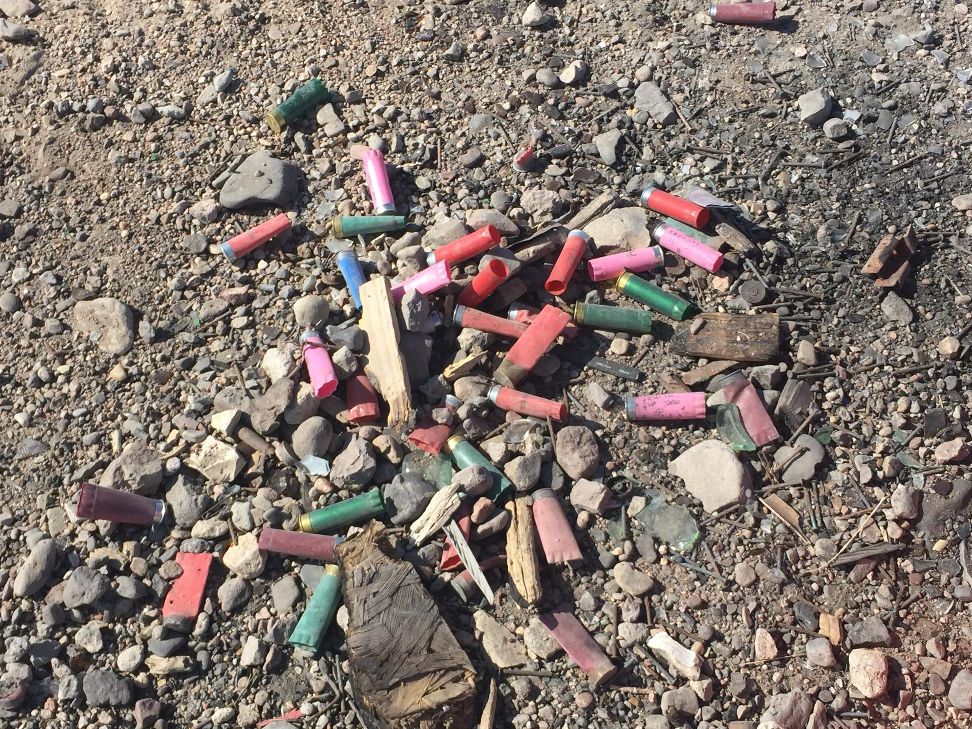
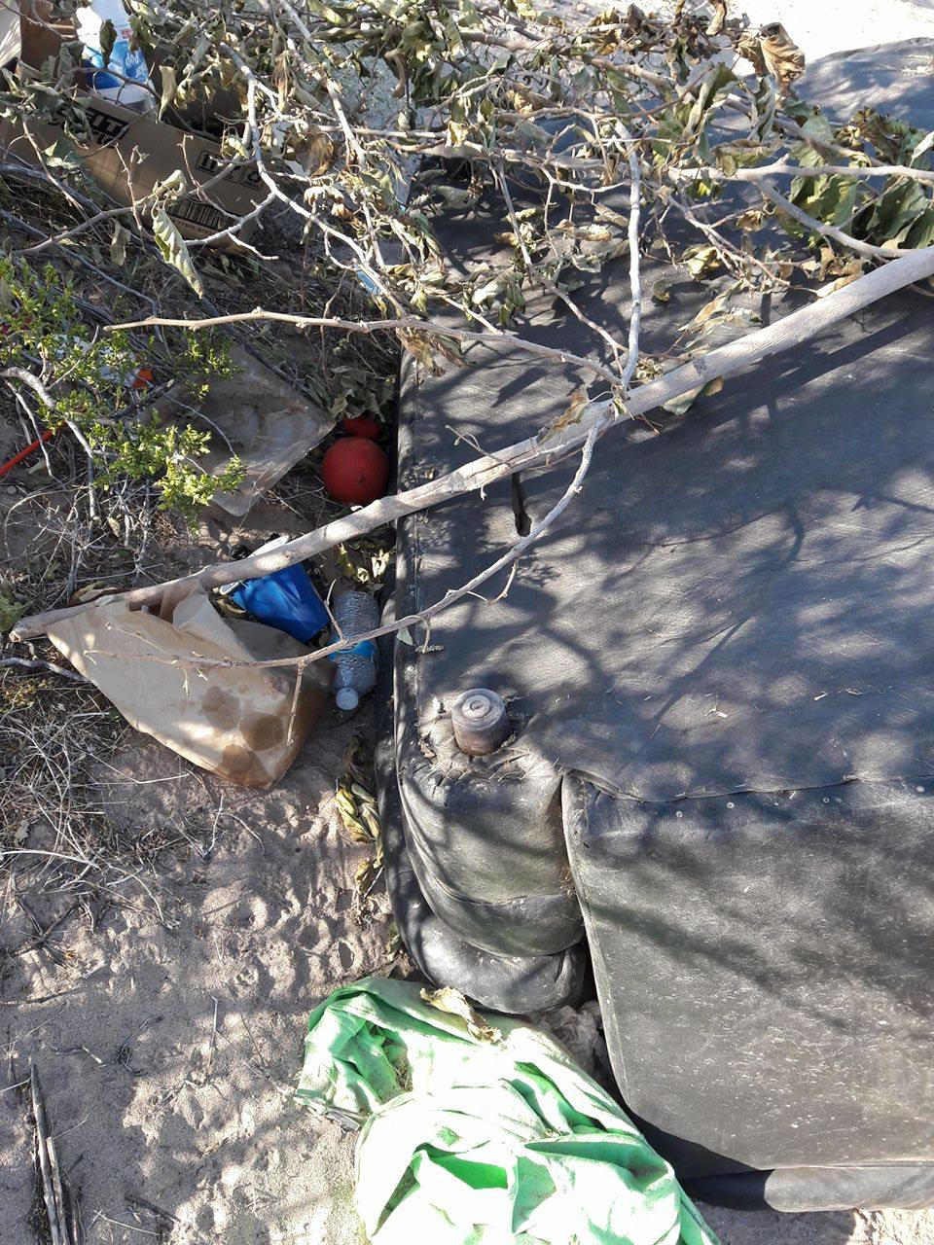
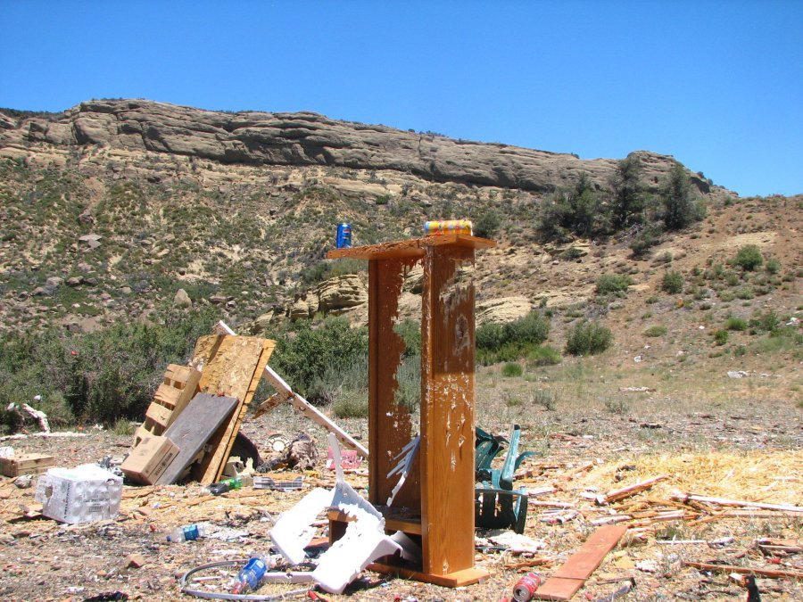
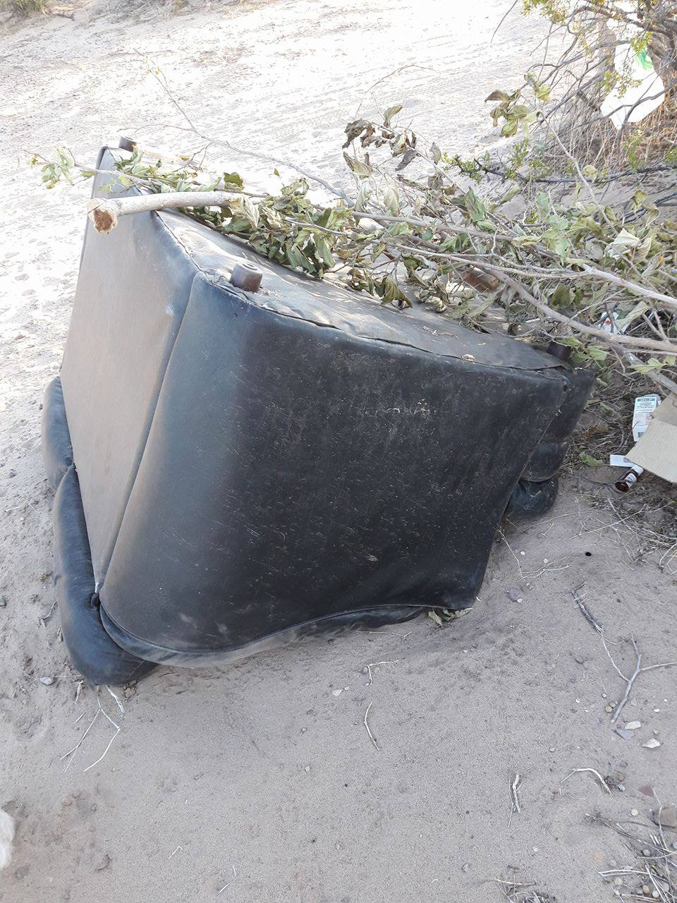
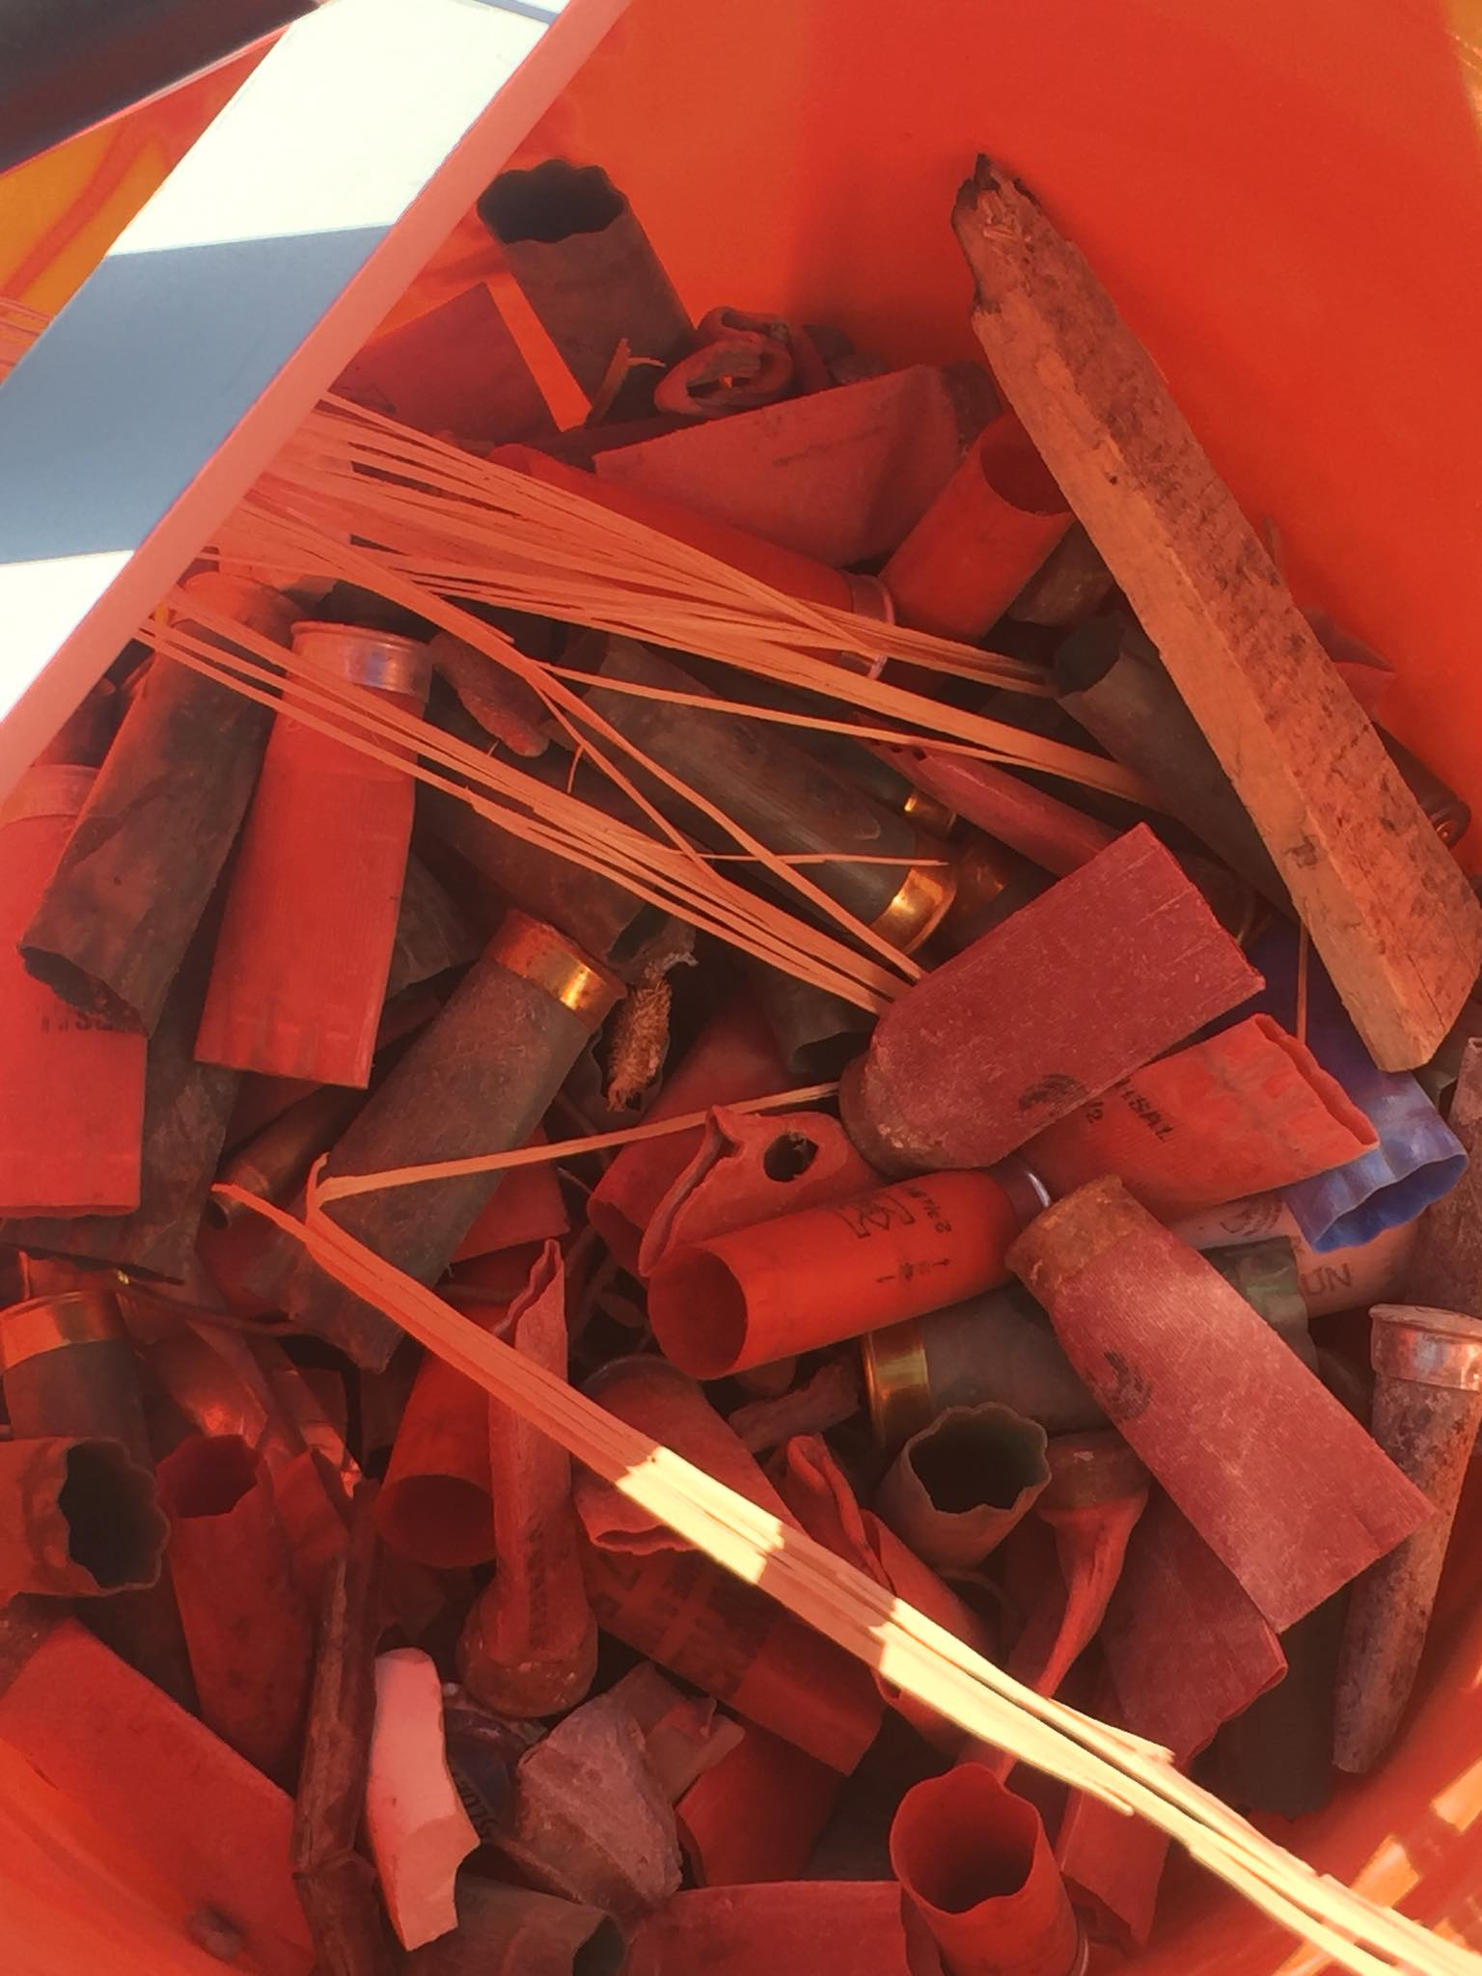
Why Public Education & Outreach?

Slide 5
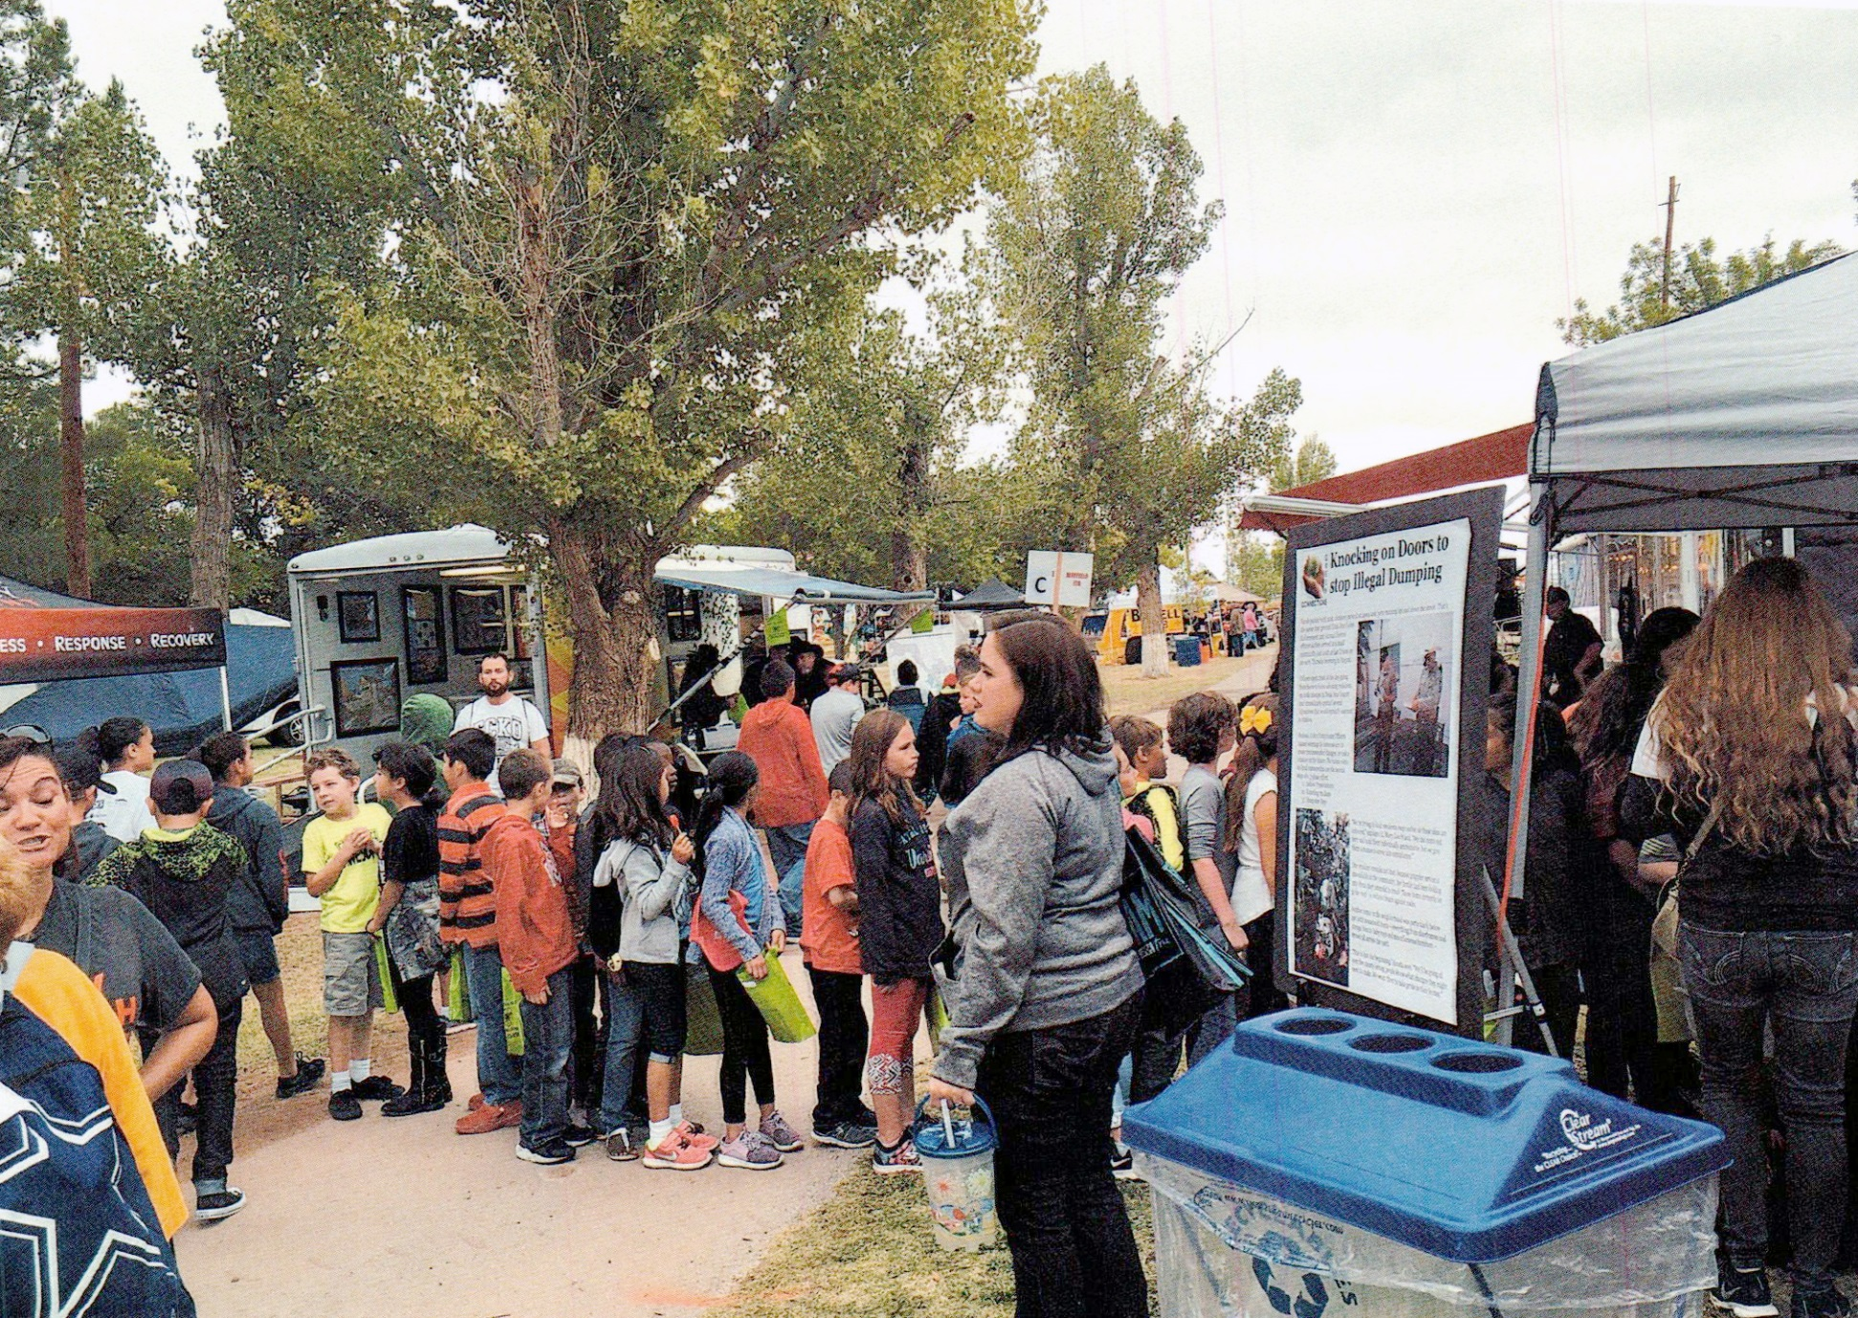
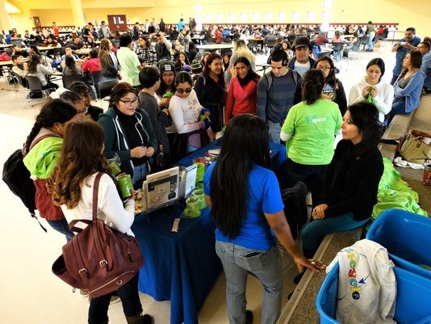
Engage with the Community through Outreach Booth & Tabling
Allows for direct contact and engagement with the community.
Best opportunity for teachable moments

Slide 6
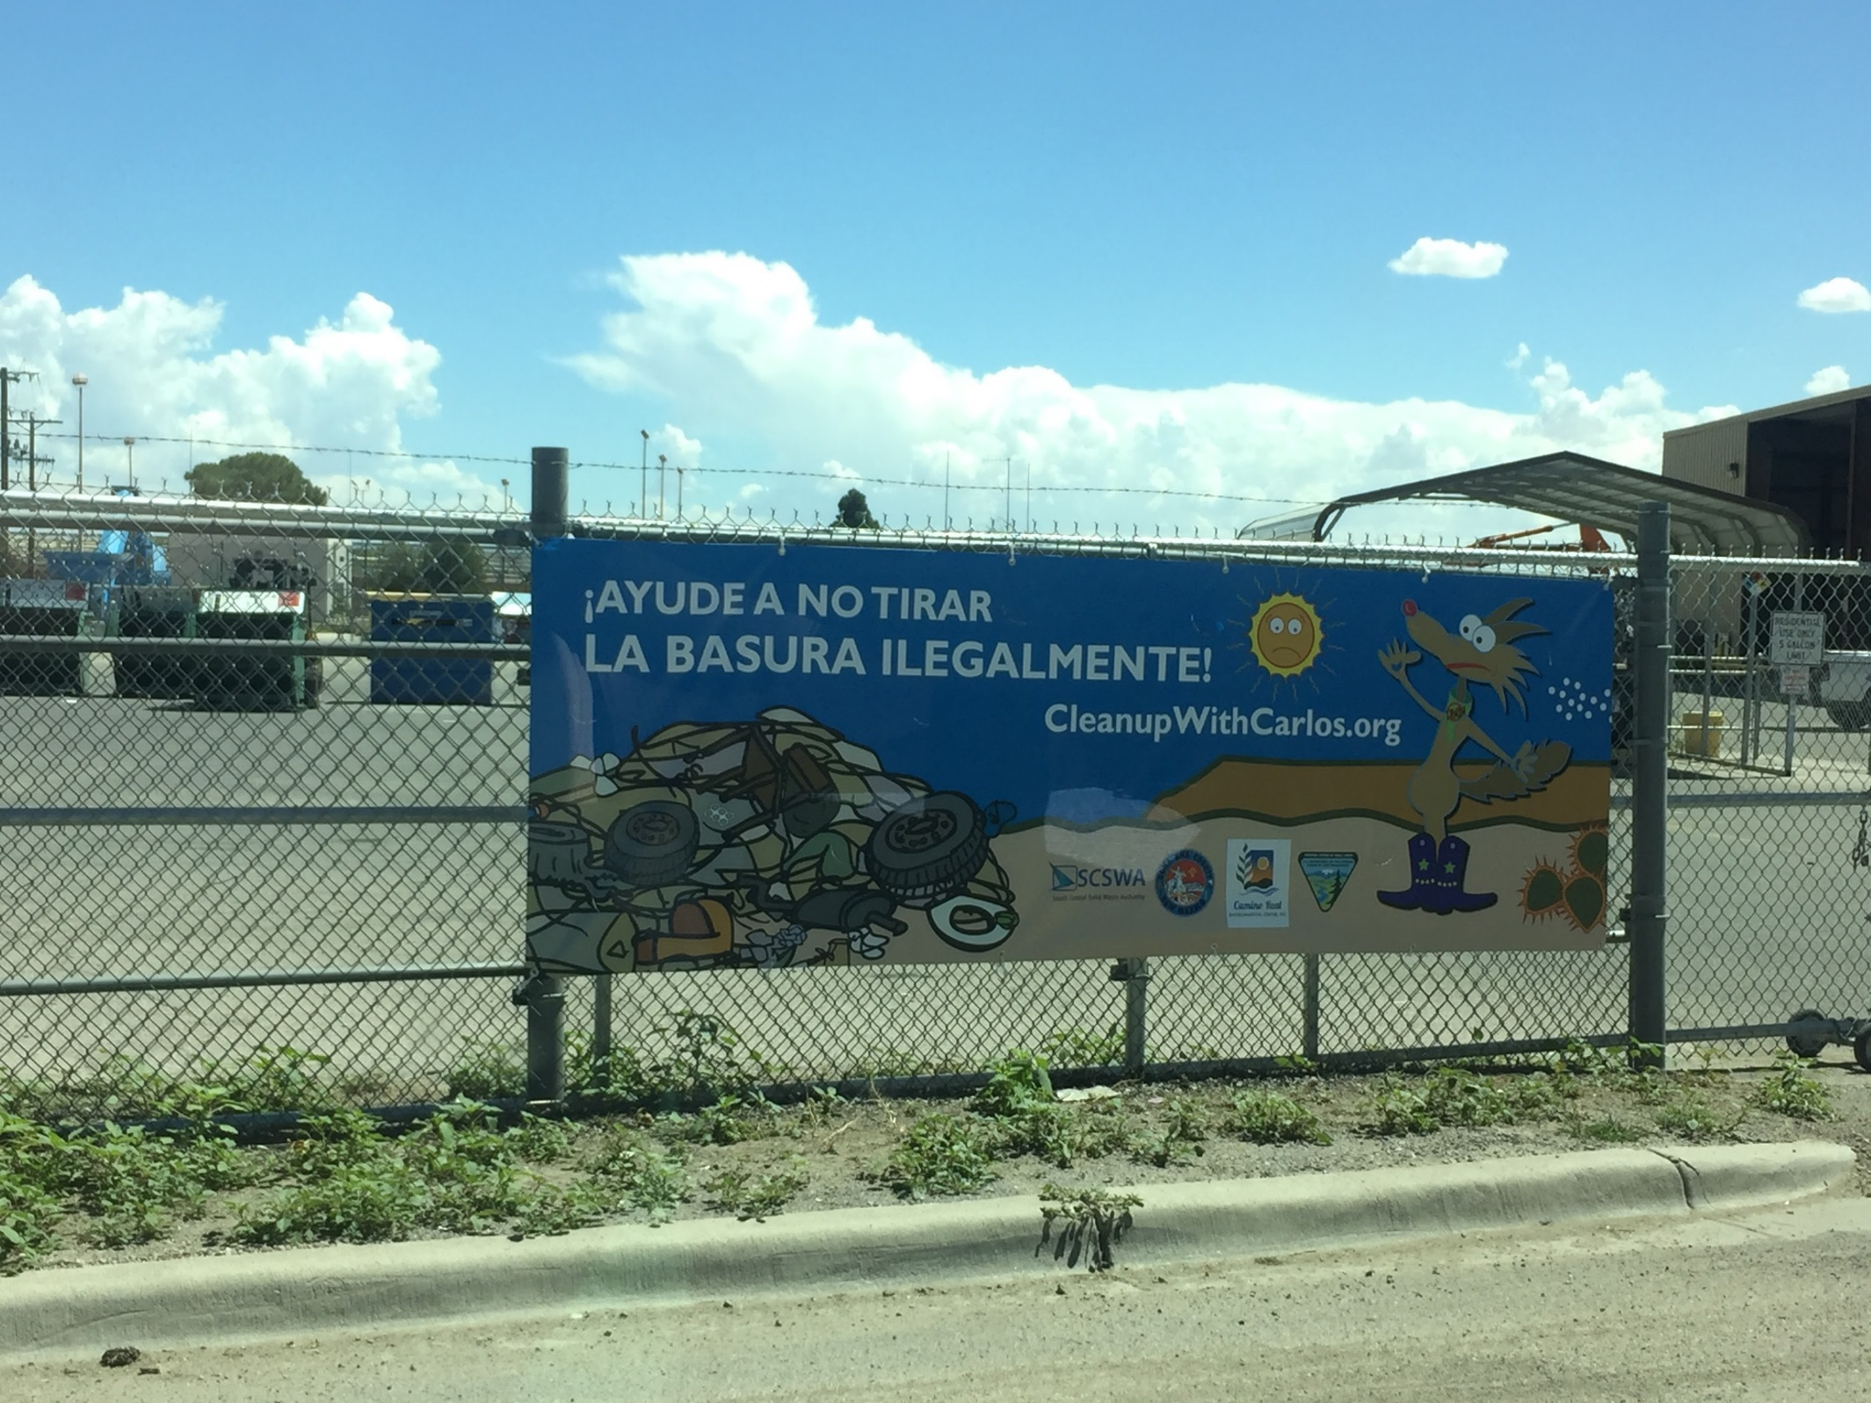


Some Common Outreach Efforts That Work
We’ve used many different options for signage that include, but are not limited to:
Banners
Billboards
Posters & flyer
Carlos the Coyote books & calendars
Featured articles in local newspapers
Notes:
Public education and outreach is needed in order to get your message out to your surrounding communities; don’t fall into the trap of “if you build it, they will come”.
Focus on public education and outreach can also help guide service policies & regulations and/or garner support on the political end for your programs.
Many grant funding opportunities often require that projects include some element of public education and outreach that will help initiate behavior change.

Slide 7
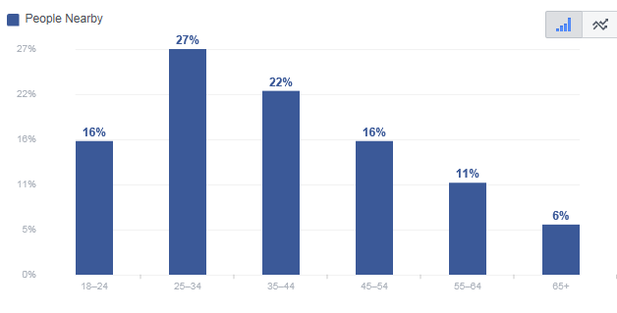
Social Media Can Work, Too
Social Media is not jus for teens and 20-somethings.
38% of our audience is between 35-54.

Slide 8
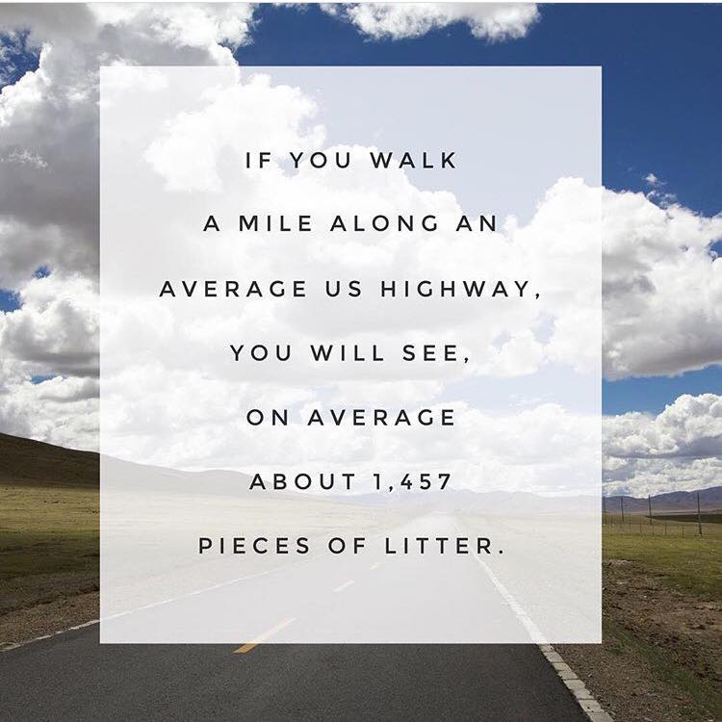
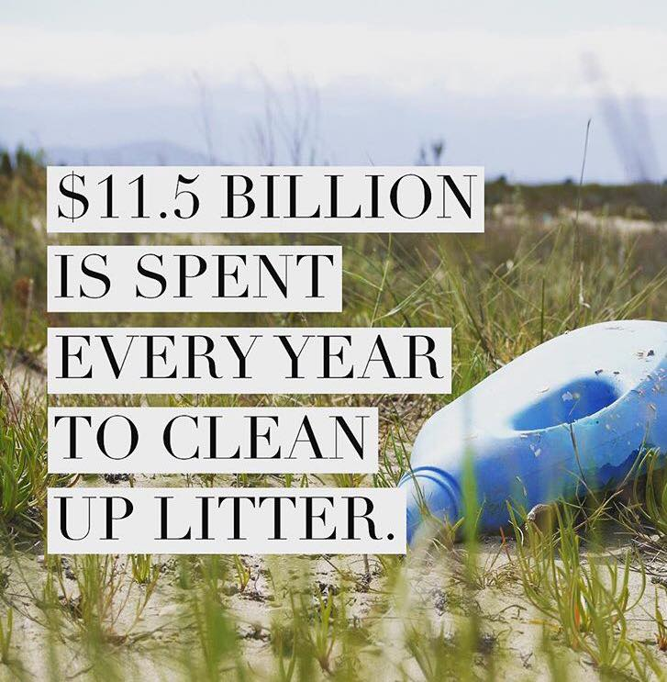
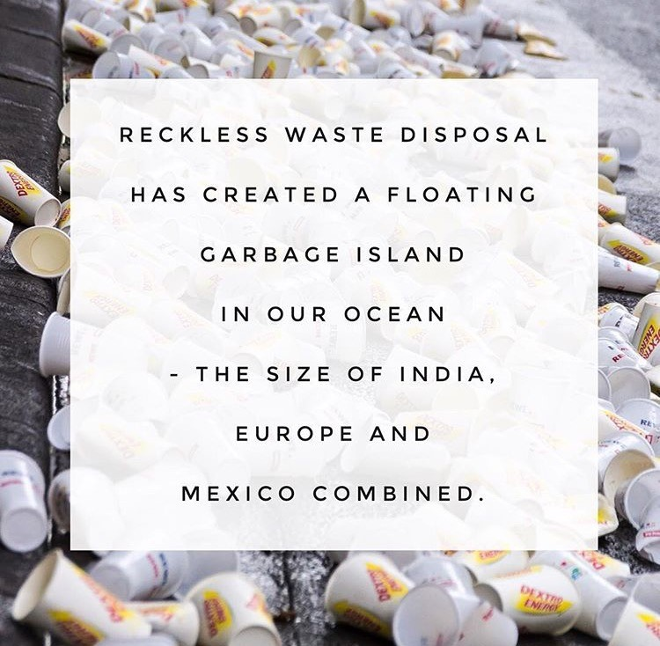
Social Media Can Work, Too
Instagram, Facebook & Twitter
  Don’t need all
  Use the outlet that your audience uses the most.
  YTD (2018) Reach = 16,669

Slide 9
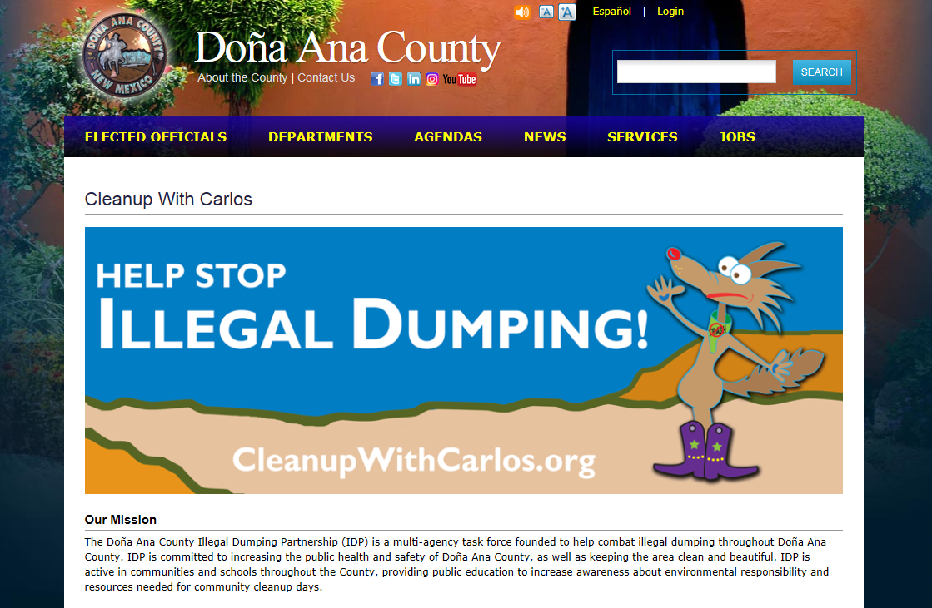
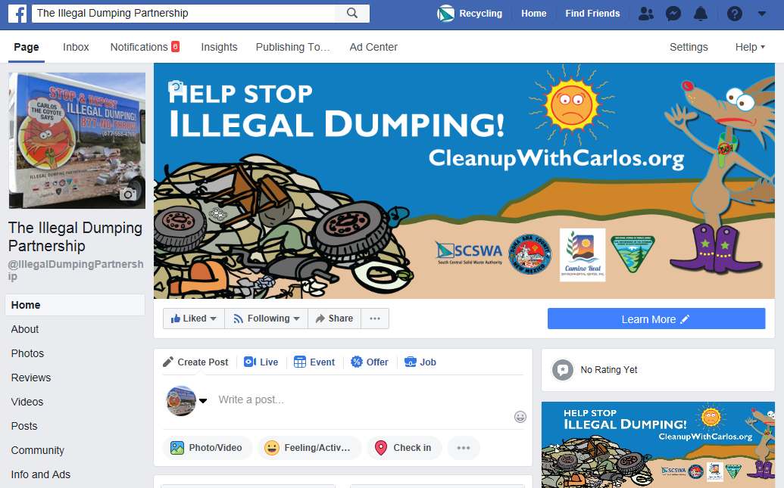
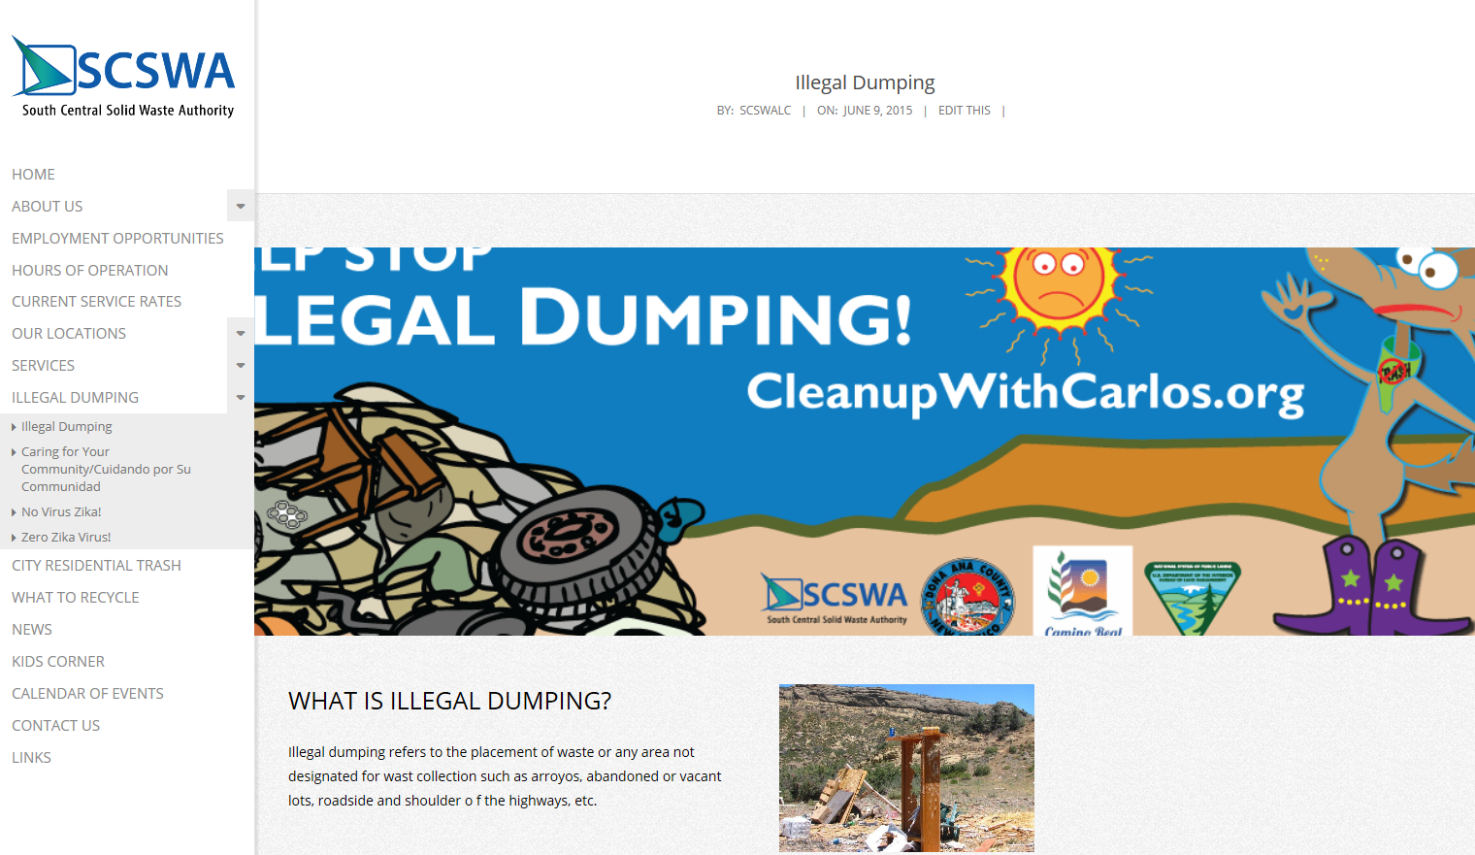
Webpage Presence x 3
The Illegal Dumping Partnership currently has three distinct webpage presence:
SCSWA.net
Facebook
CleanupWithCarlos.org

Slide 10
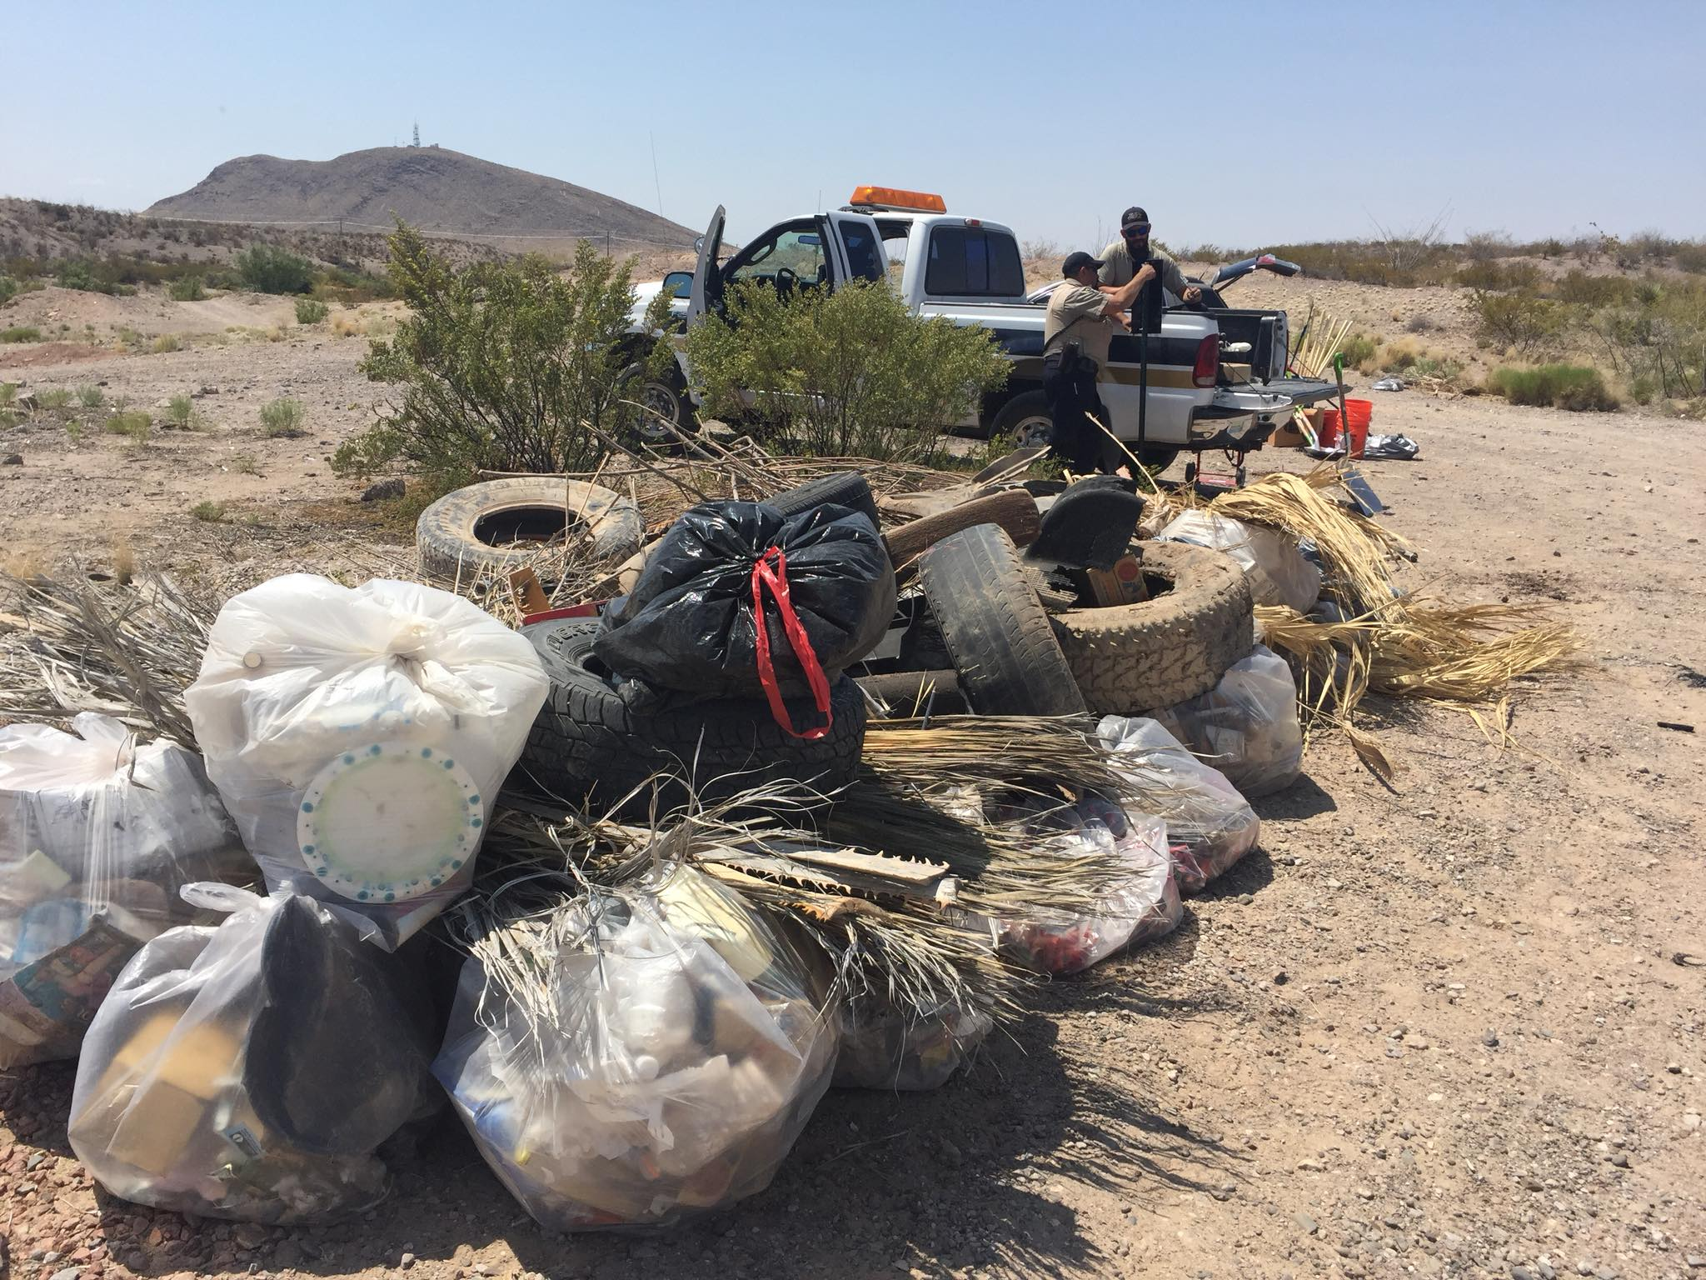
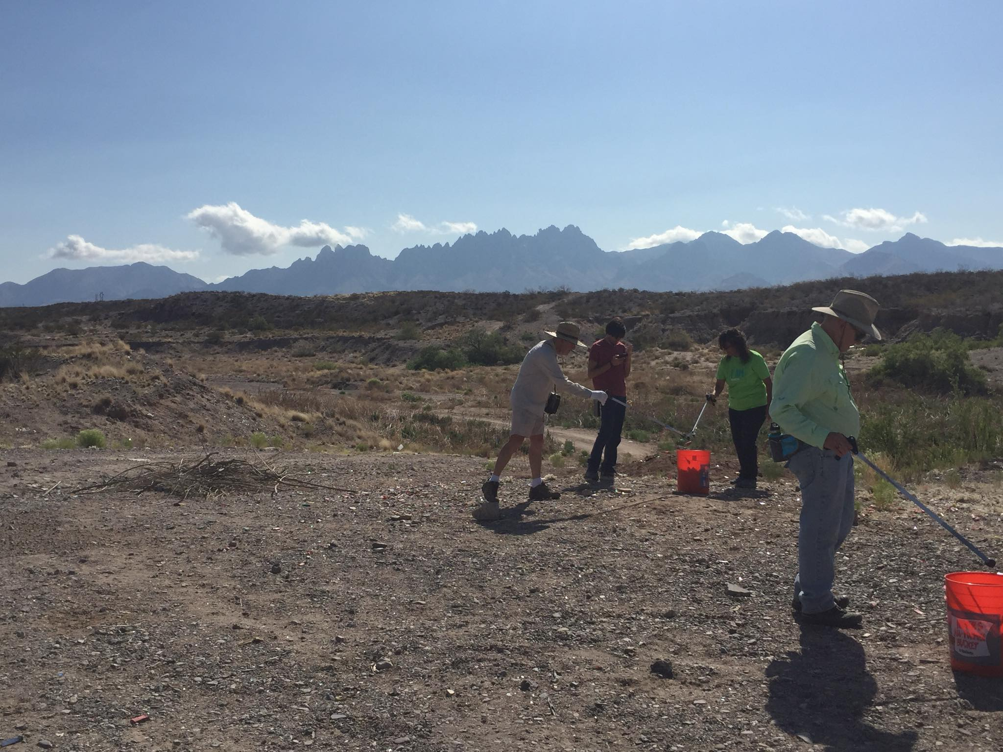
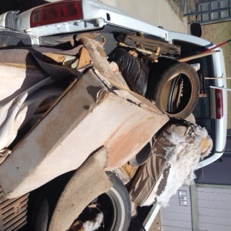
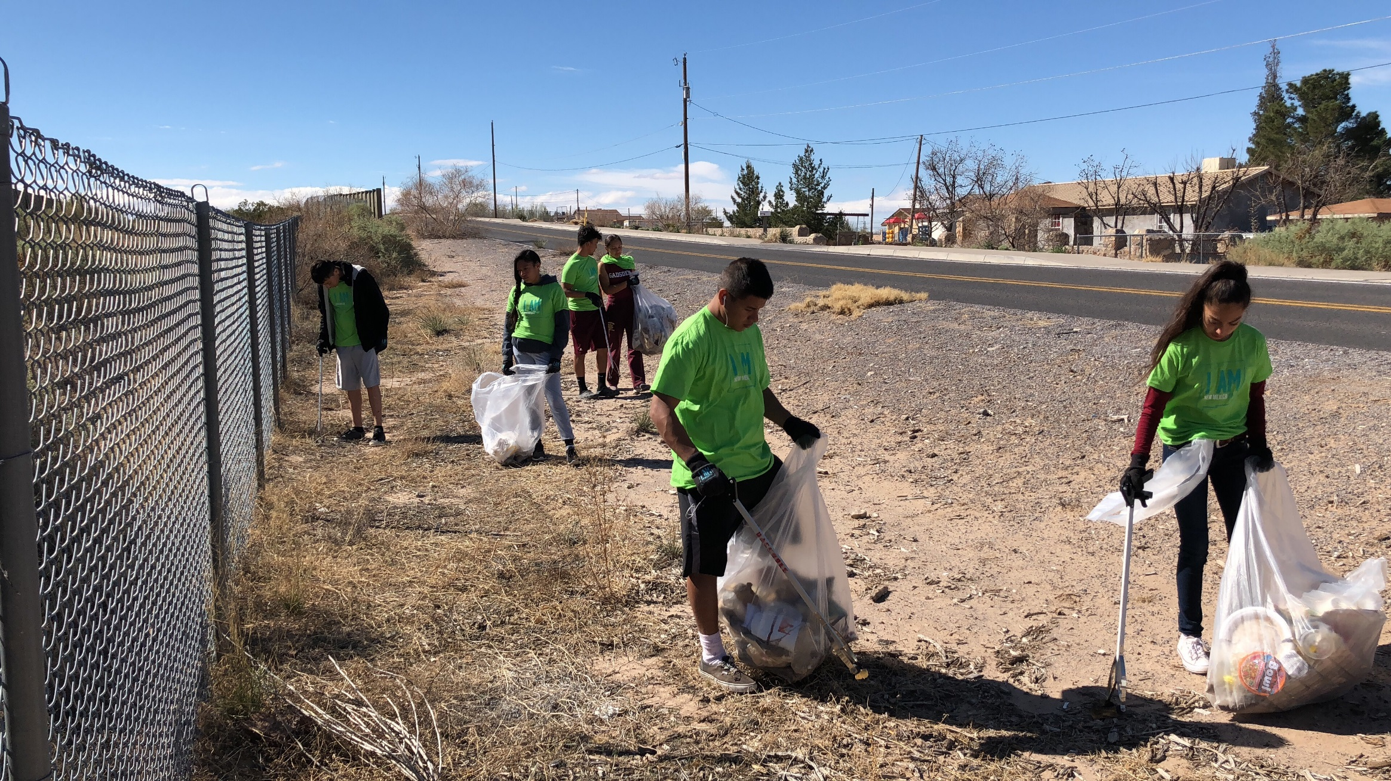
IDP Focuses on Outreach Efforts that Informs and Engages Our Community
Community buy-in
Community responsibility & behavior change
Express the dangers of illegal dumping
  Public health
  Vector and pest
Notes:
Long term goals is to initiate behavior change within the community; solicit community buy-in so that they either stop illegal dumping behavior or they actively participate in cleaning up the community.

Slide 11
8 Tips for Education & Outreach Planning
Develop a Marketing/Outreach Master Plan
Set clear objectives and parameters.
Determine how to track your campaign’s success.
Set a budget
Choose your education and outreach vehicle (billboards, printed media, social media, etc.)
Create an action plan and timeline.
Launch campaign and measure results
Tweak and/or repeat as necessary
  (time to review measurements)
Notes:
So, what could we have done differently?
Develop a great brainstorming idea into a fleshed out marketing campaign. NOTE: A Marketing Master Plan is best for overall and each additional campaign should fit into that plan.
Objectives – what do you want to achieve with your campaign? Behavior change; increased awareness?
Parameters – Are the details of your objectives such as time. How long will this campaign run?
Tracking and measurement – can you determine a campaign’s success without measurements? NO. If you don’t have measurements, you are bound to overpay or use staff time inefficiently on campaign actions that are not effective or worthwhile.
Set a budget; Would you send your kids to the grocery store with $500 without telling them what they need to buy, how long the food needs to last, etc. There’s nothing worse than trying to plan a campaign without a clear budget. You can’t plan if you don’t know how much is available.
Choose your marketing vehicle wisely. Some vehicles will be better than others. NEVER choose your vehicle based on you what YOU use. Always choose your vehicle based on the vehicle most used by your target audience/customers. Think about your target market's haunts and habits when you're choosing channels to reach them. Where do they spend their time? Where are they most likely to see or hear and pay attention to information about your products and/or services? In a magazine? On a bus bench? On their smartphone?

Slide 12




Contact Information
Keysha Burton
Outreach and Education Coordinator
South Central Solid Waste Authority
575 528-3800
tburton@las-cruces.org
      Website: www.scswa.net
      Facebook: @theSCSWA
      Instagram: @SCSWARC
      Twitter: @theSCSWA
Notes:
In short, any marketing plan/campaign is better than none because at least you’re directing your marketing efforts instead of blindly casting out effort here and there. The best marketing campaign is the one that achieves the results you want and that takes planning and coordinated effort.

